Slide 1

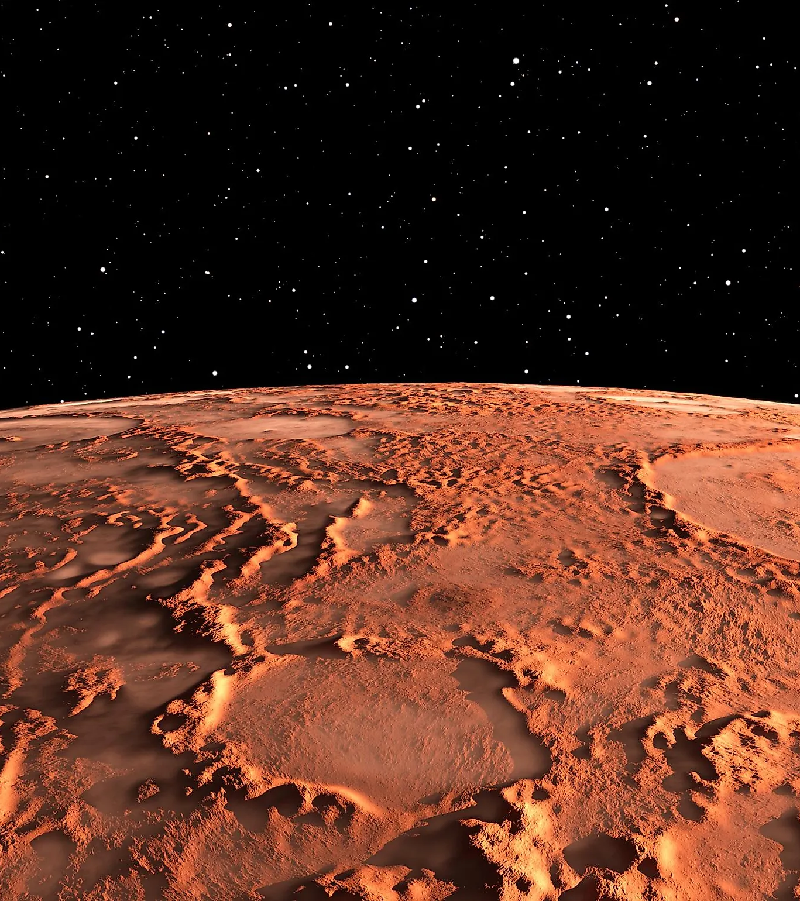



Contour Mapping of Crustal Magnetism on Mars
Daniel Gonzalez
Dr. Lon Hood
NASA/Arizona Space Grant
University of Arizona

Slide 2
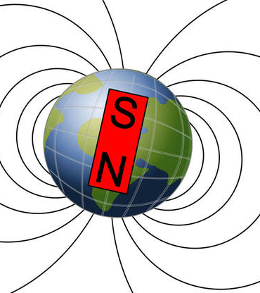
Background
-
Mars does not have global magnetic field
Suggested it once did, but no longer has one
Crustal Magnetism
History of magnetism on Mars
Crust contains:
Magnetite, Titanomagnetite
Iron Sulfides
Iron Oxide – Mars is red

Slide 3
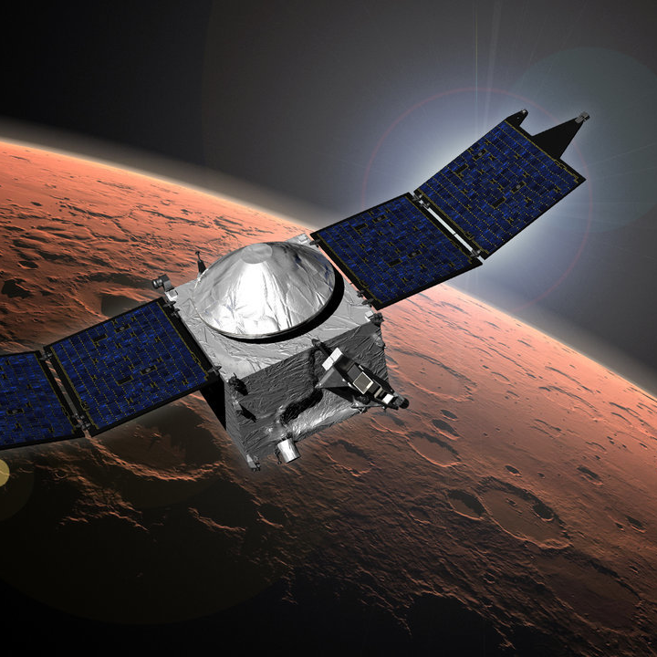
Maven
Satellite that orbits the Martian atmosphere
Collects data on the crust with magnetometer measurements
Used to map the crustal magnetic fields

Slide 4

Coding
Primary languages were FORTRAN and IDL
Select files select orbits over specific latitudes
Order files order the orbits by longitude
Super Mongo program converts the data into stack plots

Slide 5
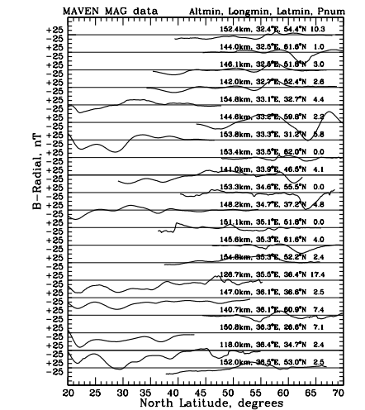
Stack PLots
Stack Plot of 20 different orbits
Nanoteslas are the unit of measurement
1/50,000 of the Earth's field
Solar wind interference
Eliminate corrupted orbits
Place remaining orbits in edited file
From edited file develop contour map

Slide 6
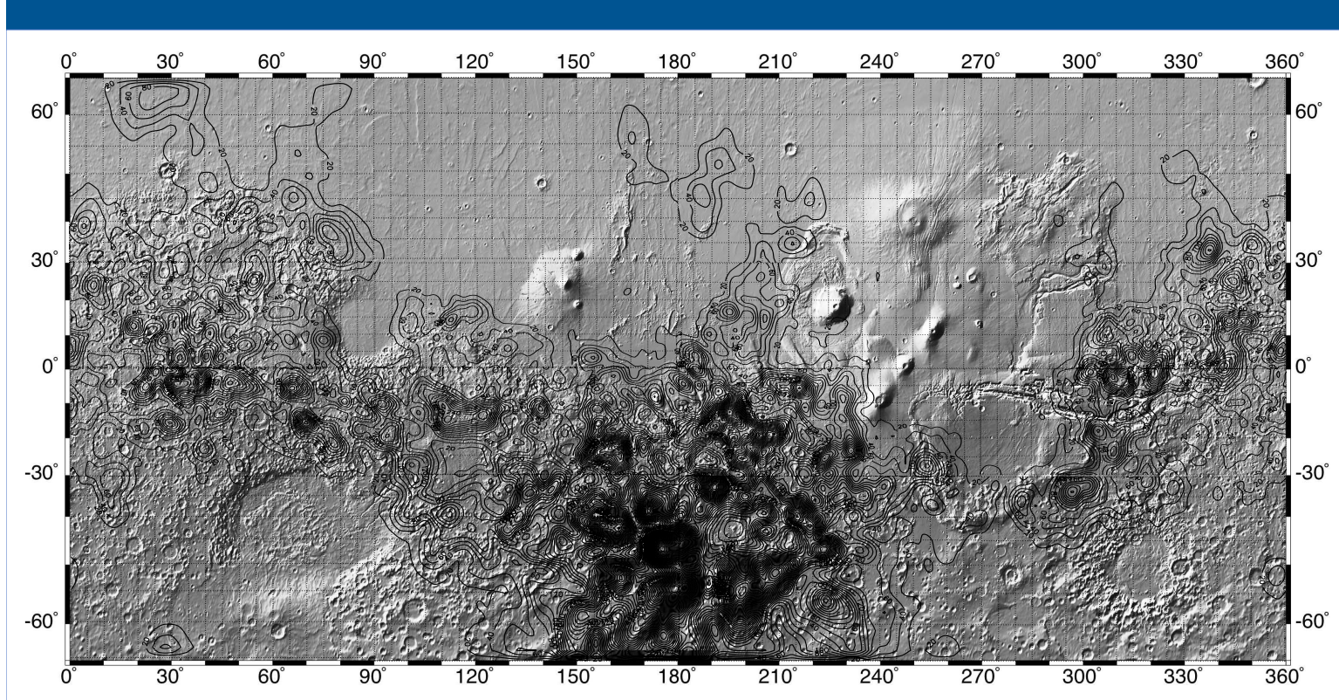
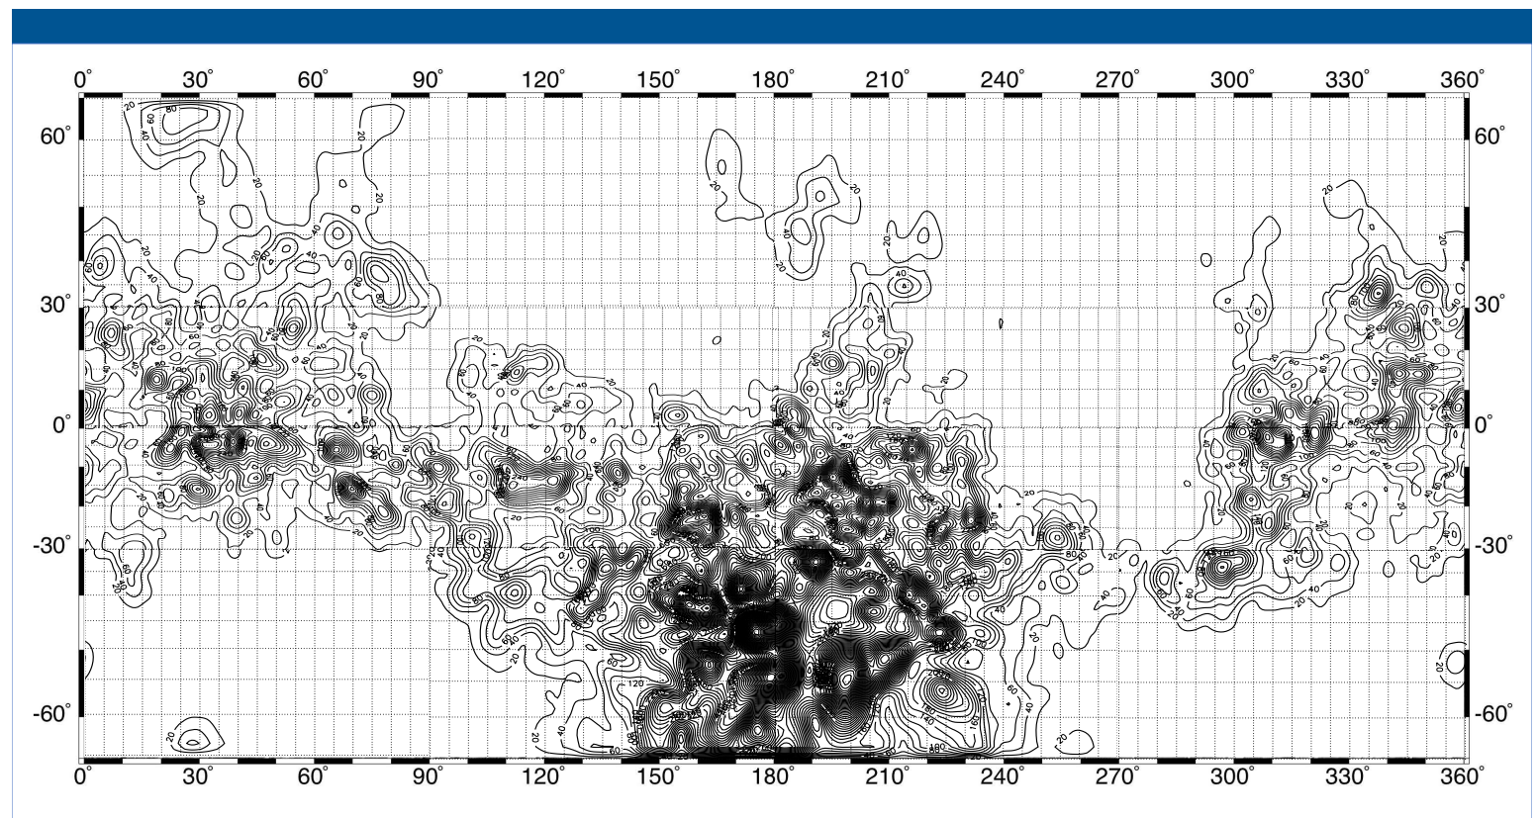
Martian
Contour Map
Not topography (elevation)
Adjusted to 150 km altitude
20 nanotesla intervals
Map of the strength of magnetic fields
Peak 1,200nT = 1.2 microteslas
Field at the surface is much larger
Regions of weak magnetism
Reasons for demagnetization

Slide 7
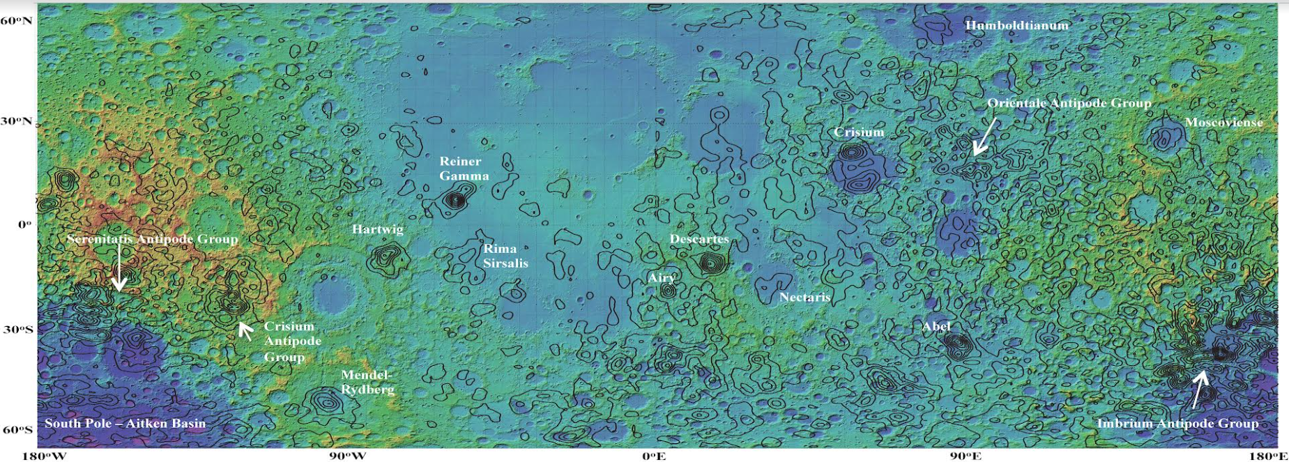
Moon Map
Map of the strength of magnetic fields
Measured in 1 nanotesla intervals
Magnetism is due to metallic iron
No atmosphere
Less iron than on Mars

Slide 8
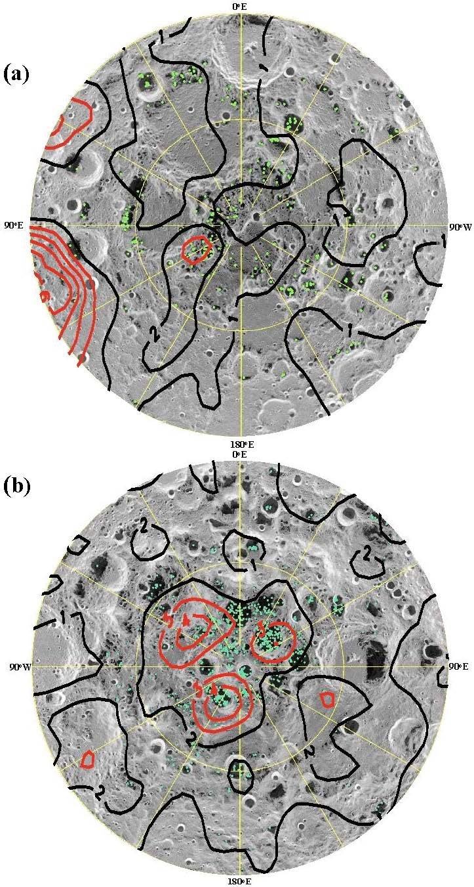
Artemis Missions
Voyage to the South Pole
More water in the South Pole than the North
More magnetism on the South Pole than the North
Suggested that magnetism Protects against solar wind

Slide 9
Thank you!

